Slide 1


Notes:
1

Slide 2
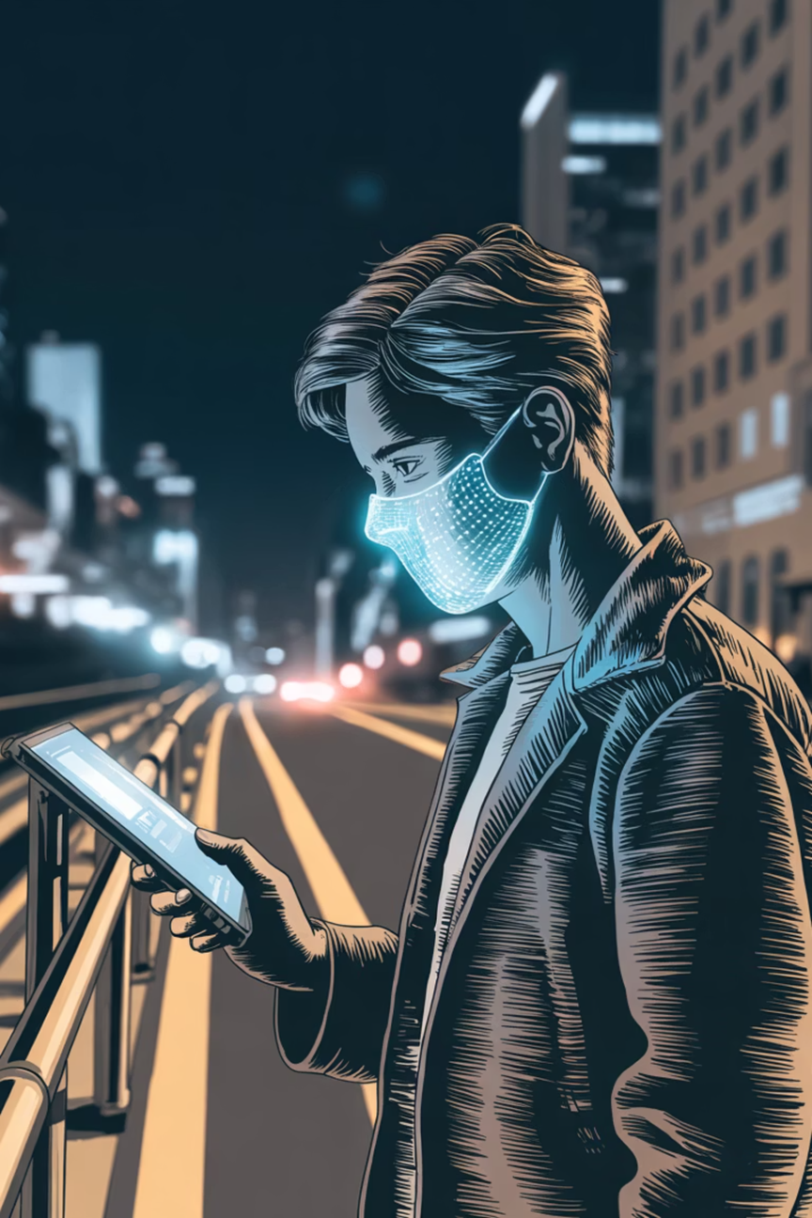


Face Mask Detection System
An Automated Deep Learning Solution for Public Safety Monitoring
Notes:
2

Slide 3

Group Members
Rehmat Ullah
BC220404931
Notes:
3

Slide 4
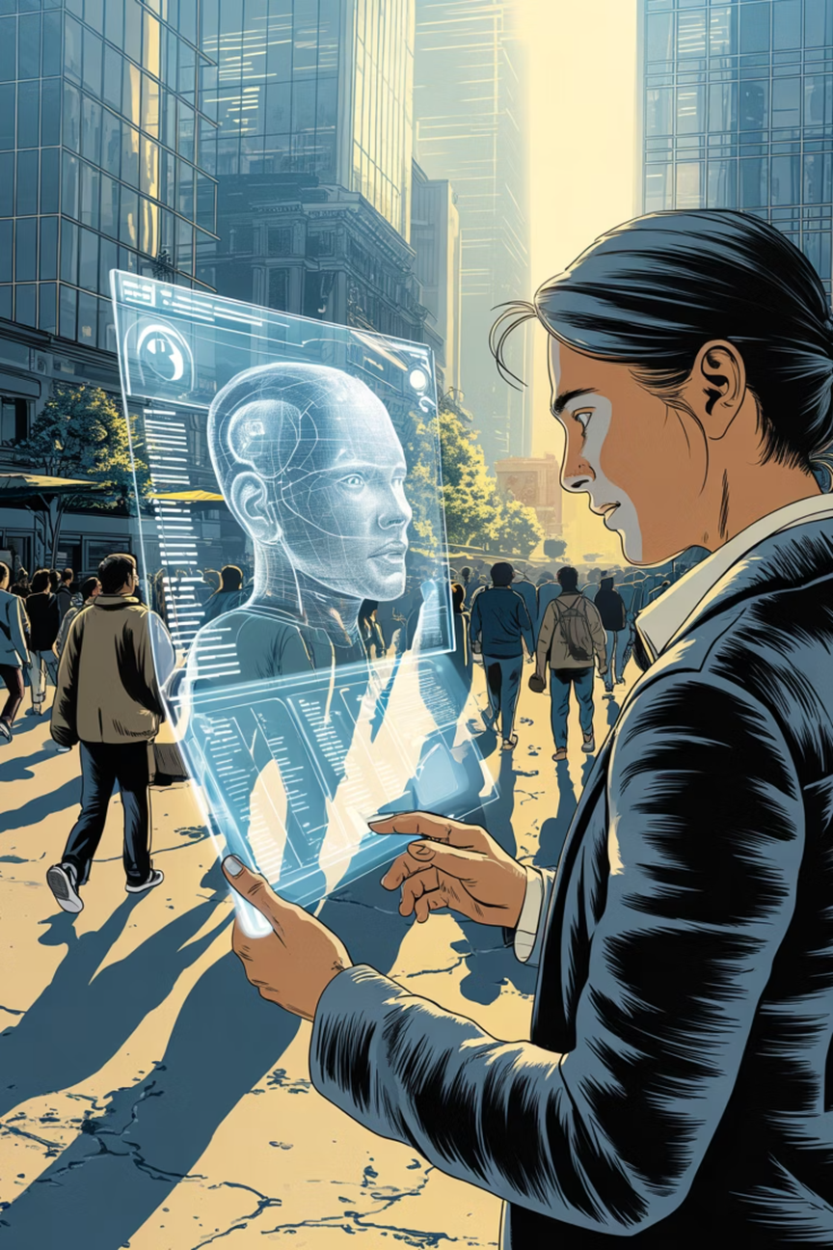

INTRODUCTION OF PROJECT
01
Project Overview
Development of an automated Face Mask Detection System using deep learning techniques. The system processes images and real-time video streams to detect mask-wearing compliance.
02
Objective
Build a reliable deep learning model for accurate mask and no-mask classification. Process images and live webcam feeds while reducing manual monitoring efforts in public spaces.
Notes:
4

Slide 5
INTRODUCTION OF PROJECT
03
Technology Used
The system is developed using a Convolutional Neural Network (CNN) model.
A dataset of masked and unmasked faces is used for training purposes.
Real-time detection is implemented using computer vision techniques.
04
Working Concept
The system captures input from images or webcam feed.
Faces are detected and passed to the trained deep learning model.
The model classifies each face as “Mask” or “No Mask” and displays the result instantly.
Notes:
5

Slide 6
INTRODUCTION OF PROJECT
05
Applications
Public safety and surveillance systems
Hospital and clinic entry monitoring
Smart attendance and security systems
Automated monitoring in crowded places
Healthcare Monitoring
Crowded Places
Hospital and clinic entry verification systems
Automated monitoring in events and venues
Notes:
6

Slide 7
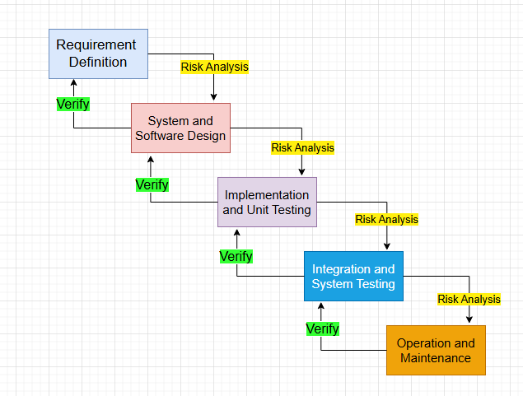
VU Process Model
Notes:
7

Slide 8
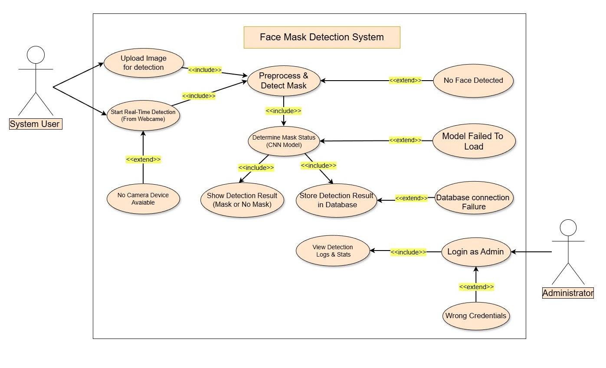
Use Case Diagram
Notes:
8

Slide 9

Business Rules Catalog
Notes:
9

Slide 10

Business Rules Catalog: Data & Model
Data Collection & Preprocessing
Collect face images with and without masks. Apply OpenCV or MediaPipe face detection, resize and normalize images, and perform data augmentation through rotation, flipping, and brightness adjustment to improve model generalization.
1
Model Development
Implement a CNN or fine-tune pretrained models like MobileNet. Train for binary classification (Mask/No Mask) using dropout, batch normalization, and hyperparameter tuning to optimize performance.
2
Notes:
10

Slide 11
Business Rules Catalog: Interface & Detection
Desktop Application
Web Application
Real-Time Detection
Tkinter-based interface allowing photo uploads with prediction results and confidence scores displayed
Flask-based web interface for image uploads or live camera feed detection
OpenCV captures live video from webcam or CCTV, detects faces, classifies as Mask/No Mask, and displays bounding boxes with confidence levels
Notes:
11

Slide 12

Business Rules Catalog: Data & Performance
Database Integration
Performance Evaluation
Store detection results including timestamps, image paths, and predictions using SQLite . Enable administrators to view and analyze detection statistics through query interfaces.
Evaluate using accuracy, precision, recall, and F1-score metrics. Test under various lighting and camera conditions. Optimize for faster real-time performance while maintaining high accuracy through model compression and hardware acceleration.
Notes:
12

Slide 13
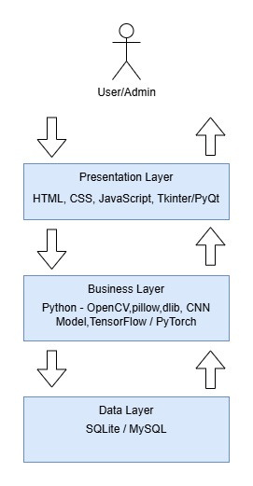
Architectural
Design
Notes:
13

Slide 14
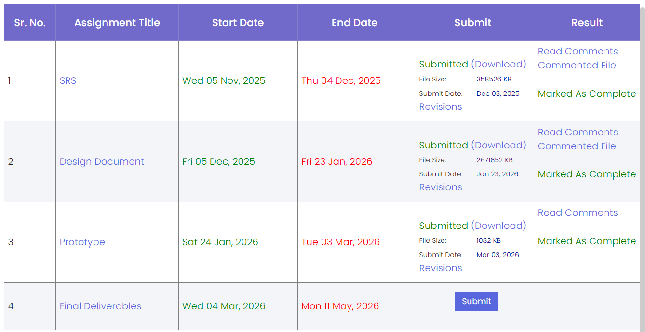
Project Schedule
Notes:
14

Slide 15

Sequence Diagrams
Notes:
15

Slide 16
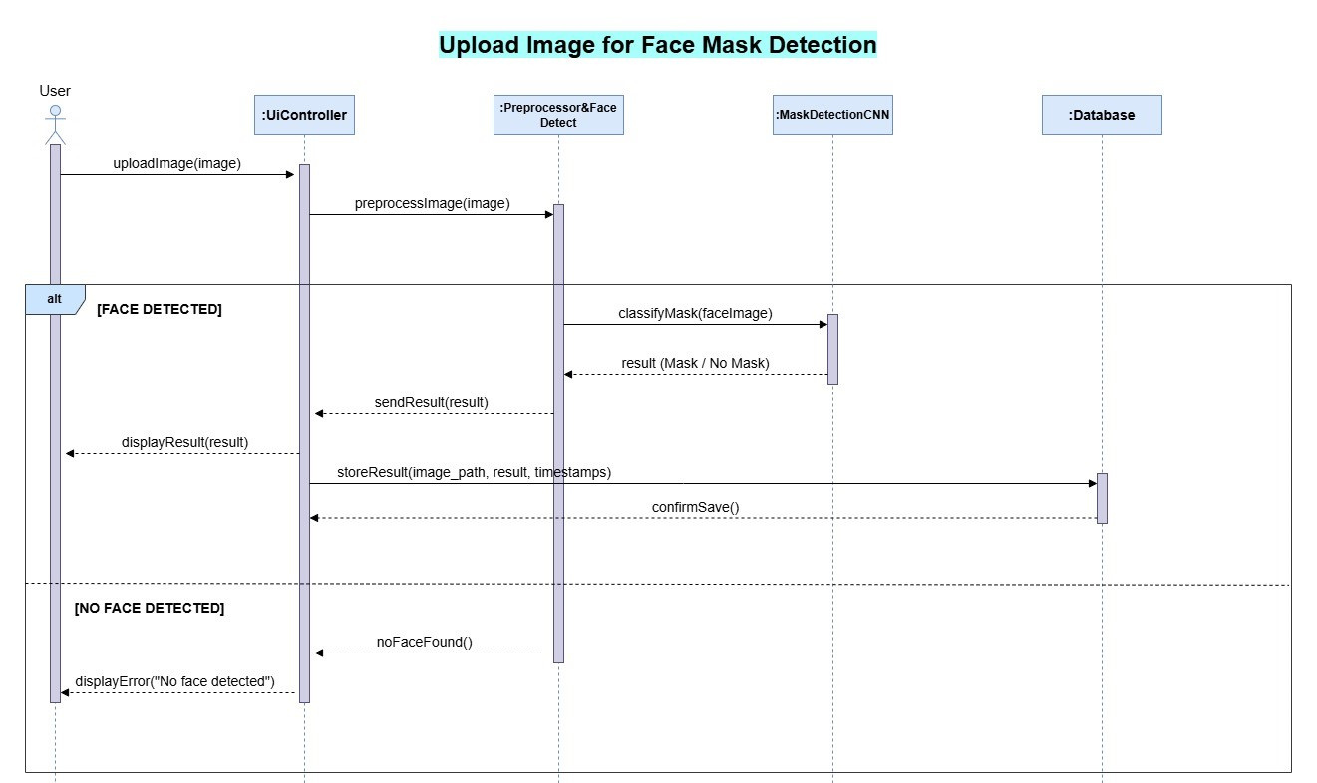
Upload Image
Notes:
16

Slide 17
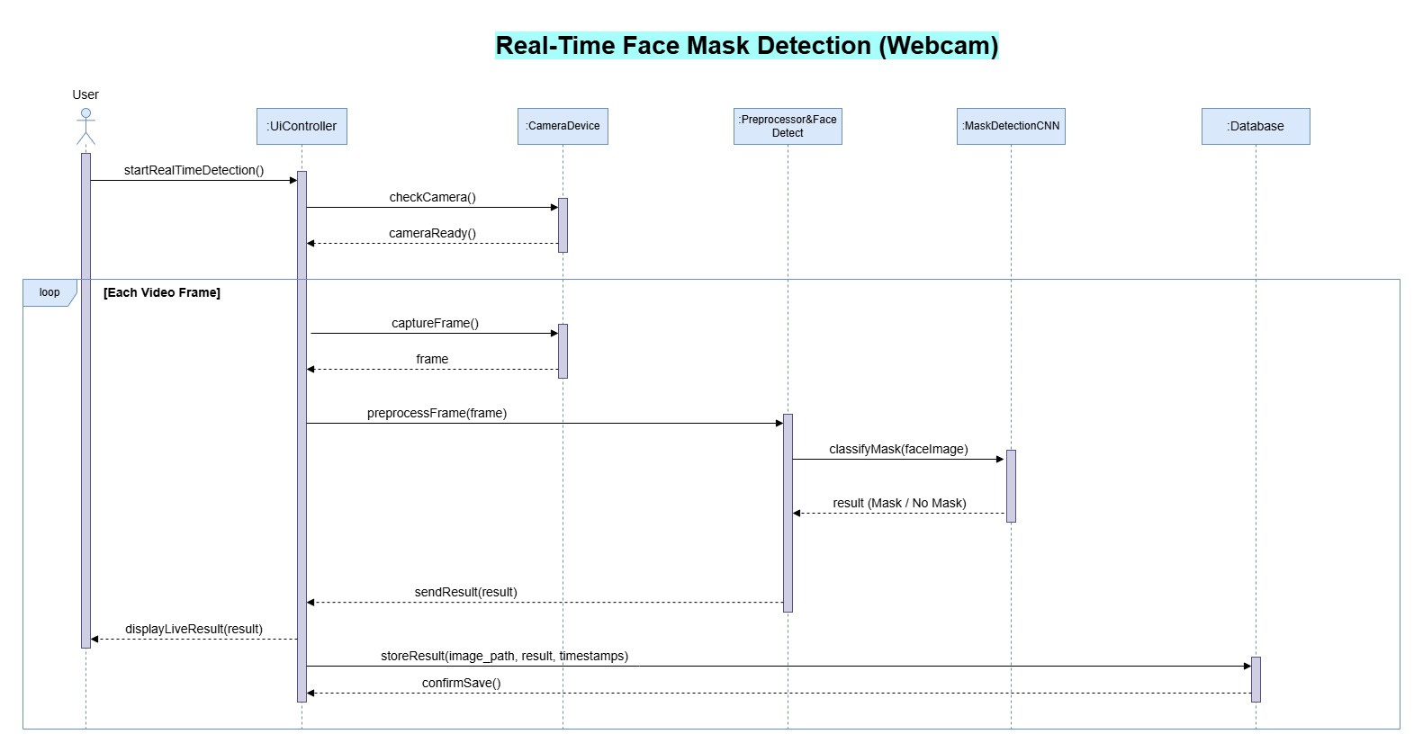
Realtime Detection
Notes:
17

Slide 18
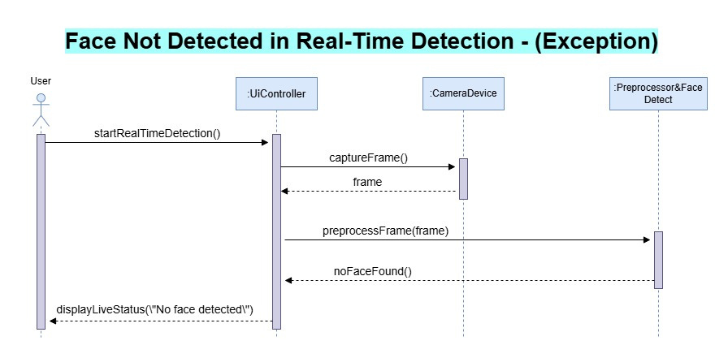
Face Not Found
Notes:
18

Slide 19
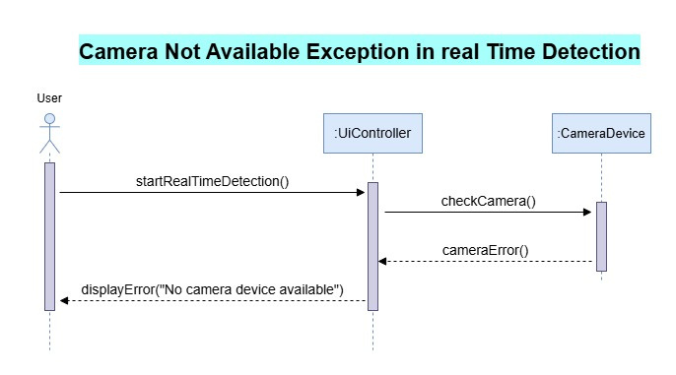
Camera Not Available
Notes:
19

Slide 20
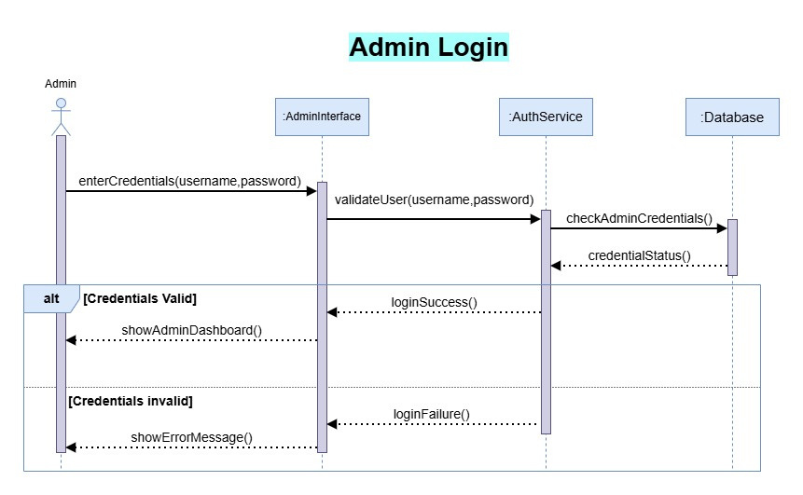
Admin Login
Notes:
20

Slide 21
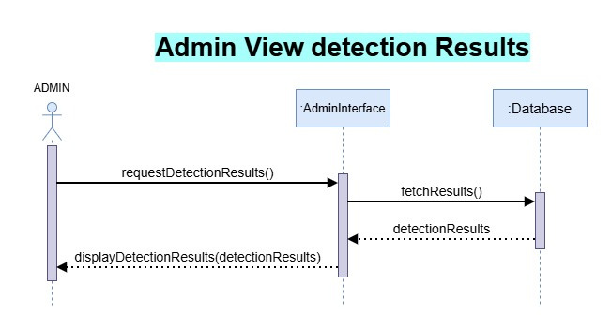
Admin View Detections
Notes:
21

Slide 22
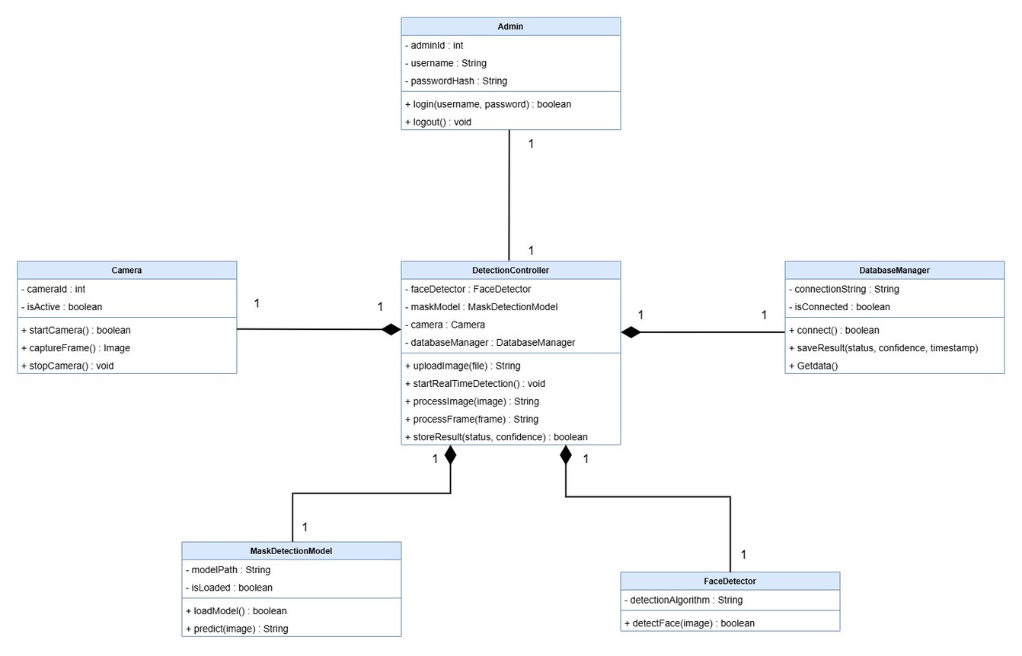
Logical Model/Class Diagram
Notes:
22

Slide 23
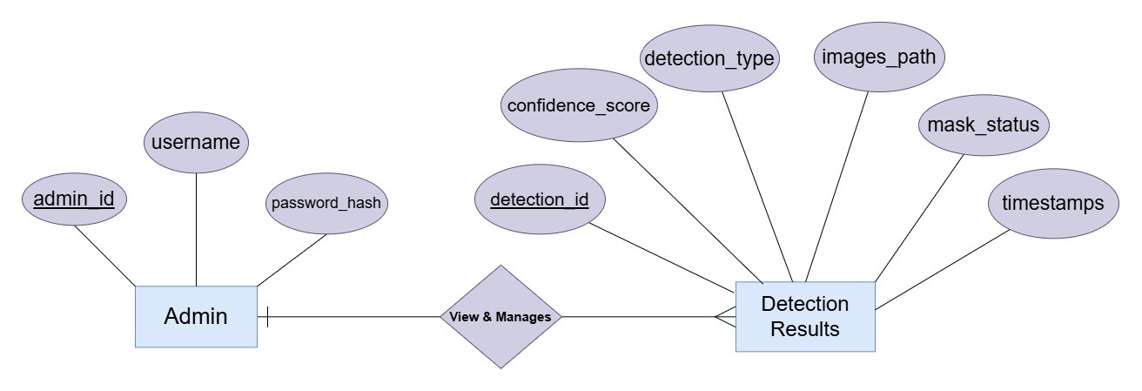
Entity-Relationship Diagram
Notes:
23

Slide 24
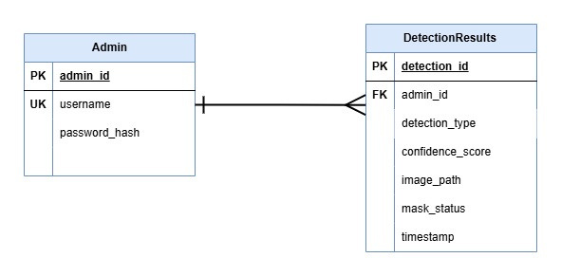
Database Diagram
Notes:
24

Slide 25
User Interfaces
Notes:
25

Slide 26
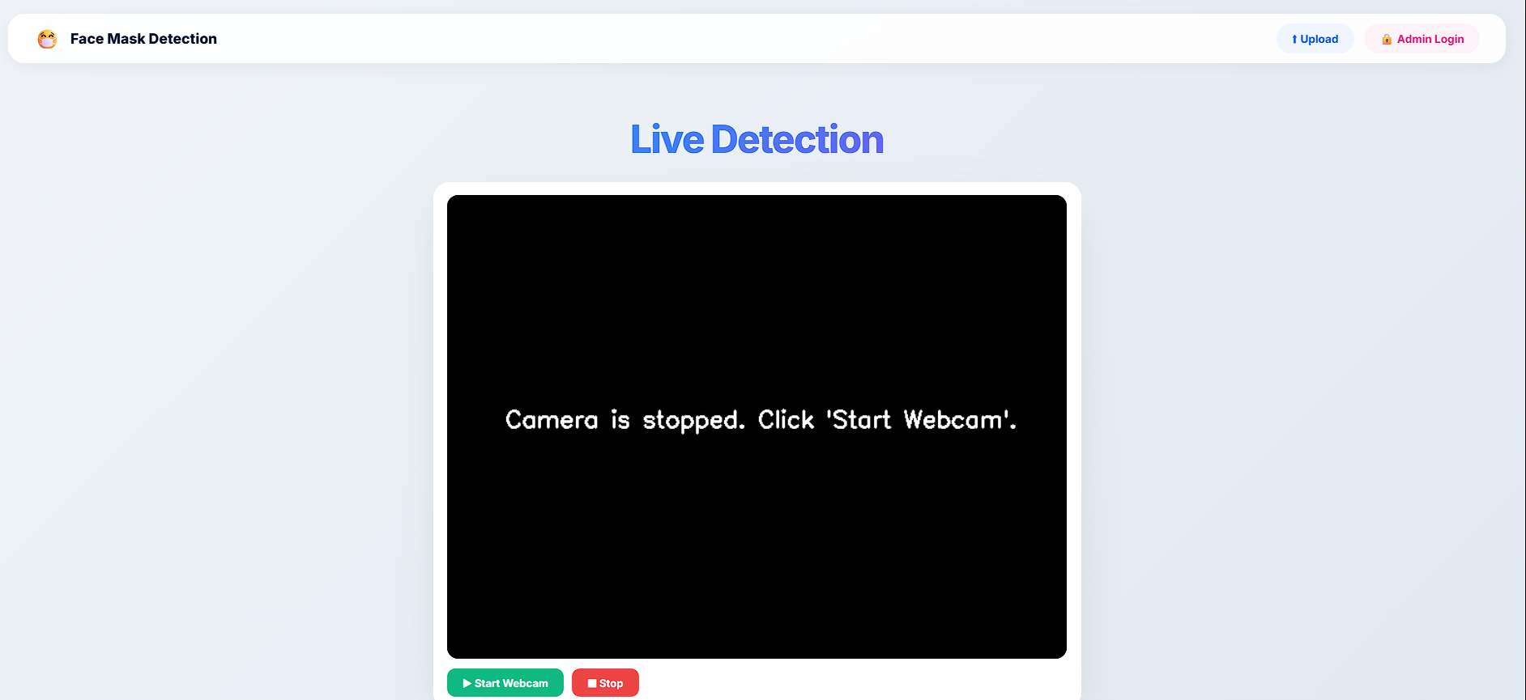
WebApp Main Interface
Notes:
26

Slide 27

Upload Image for Detection
Notes:
27

Slide 28
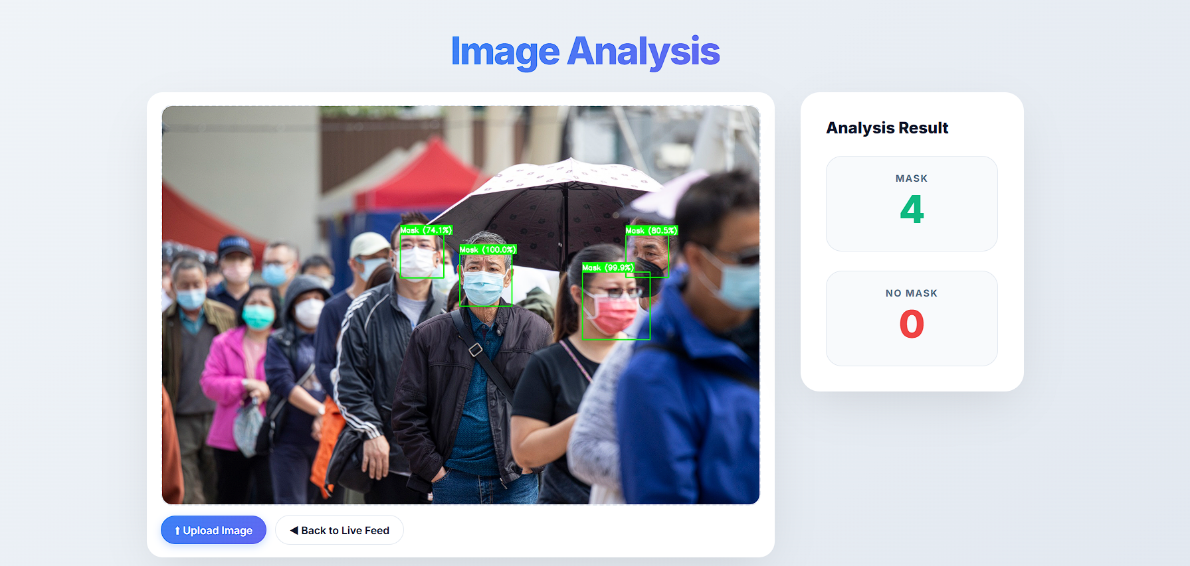
Uploaded Image Results
Notes:
28

Slide 29

Admin Login
Notes:
29

Slide 30
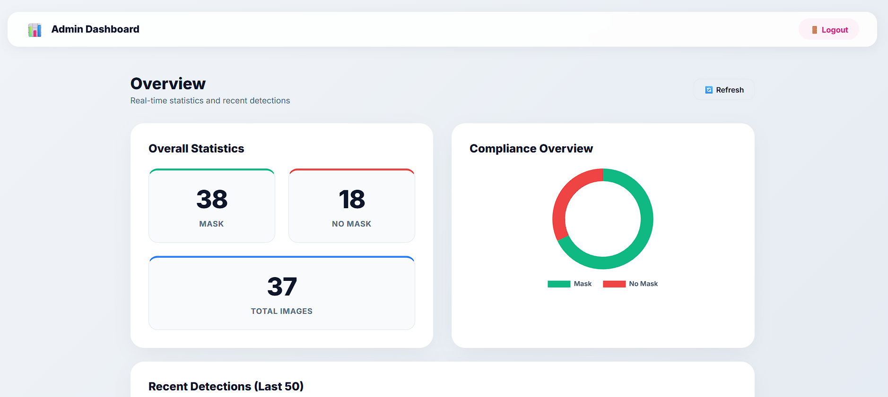
Admin Dashboard
Notes:
30

Slide 31
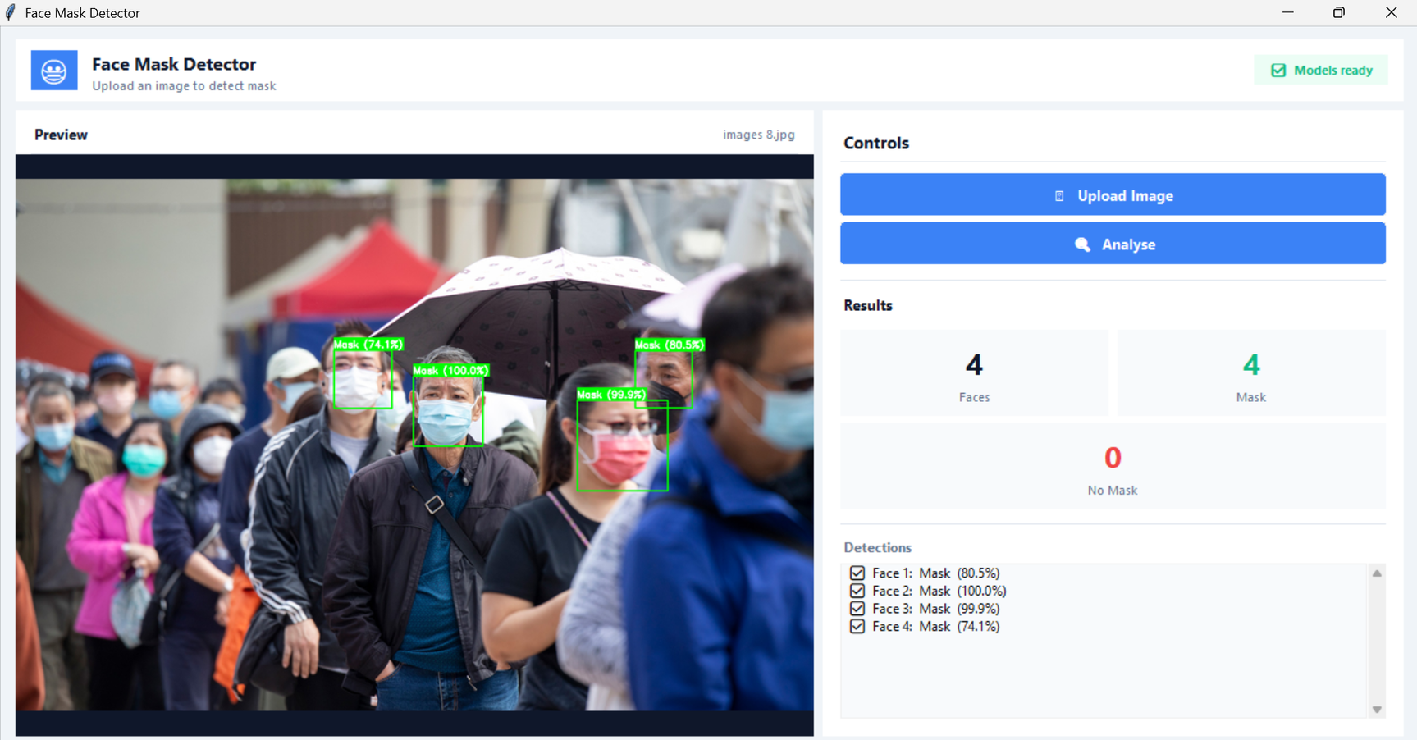
Desktop App Interface
Notes:
31

Slide 32
Tools
TensorFlow
OpenCV
Tkinter
Python
Keras
SQLite
Flask
HTML
Numpy
CSS
Notes:
32

Slide 33
THANK YOU!
Notes:
33

